Slide 1
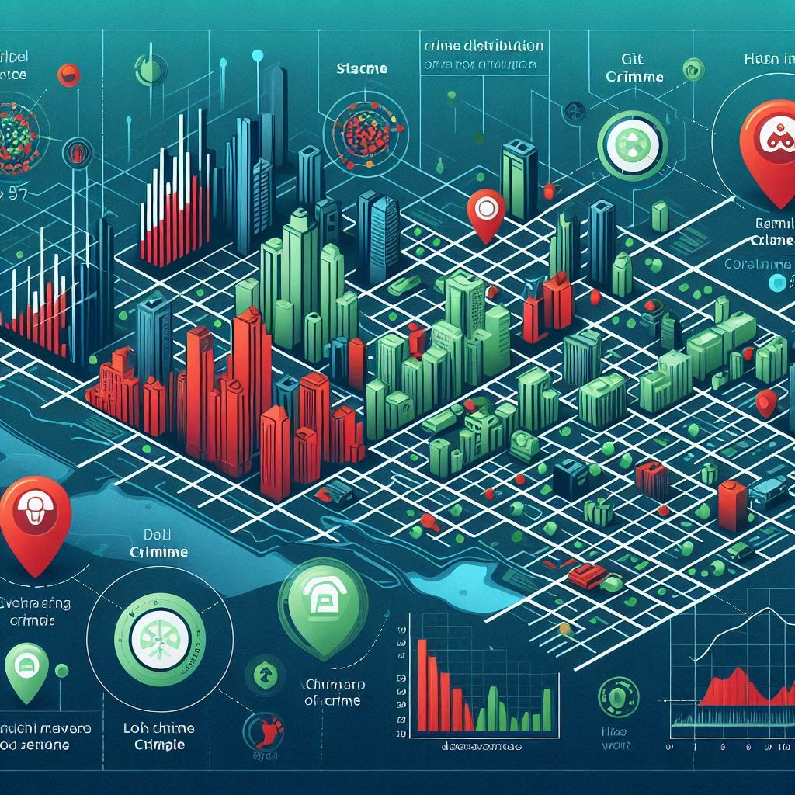
CRIME DISTRIBUTION PATTERNS ACROSS URBAN LANDSCAPES
GROUP-5
MOHITH REDDY SEELAM
SAI ASHISH BEHARA
SHIVASAKETH SIMALADARI
ROHITH CHANUMOLU
VIJAY VISWANADH JONNADULA
VARUN SAI REDDY ARUTLA

Slide 2
CONTENTS
Introduction
Problem Statement
Architecture
Algorithm
Different types of Visualization
Pros and Cons
Conclusion with Applications
Project Methdology

Slide 3

INTRODUCTION
Crime is a complex social, economic, and political issue affecting entire societies.
Understanding crime patterns and locations helps security agencies plan better defense strategies.
Traditional crime analysis relies on limited, static statistics and struggles to adapt to socio-economic changes.
This study analyzes U.S. metropolitan crime distribution from 1960 to 2024.
It explores relationships between crime and poverty, employment, education, and income levels.
The project moves beyond basic crime databases to uncover long-term drivers of crime in various states.
Goal: Use data analytics to enhance crime prevention and build safer, more resilient communities.

Slide 4

PROBLEM STATEMENT
Problem Statement 1: Traditional crime analysis methods rely on limited statistical tools and fixed crime reports, which are insufficient for capturing the evolving patterns of criminal activity influenced by socio-economic changes over time. There is a need for dynamic models that integrate both crime statistics and synthetic socioeconomic indicators to uncover hidden crime patterns.
Problem Statement 2: Current crime databases lack the capability to perform meaningful spatiotemporal analysis across decades and regions. This hinders law enforcement and urban planners from identifying long-term crime trends and allocating resources effectively. A scalable analytical system is required to process large-scale historical crime data and generate actionable insights.

Slide 5
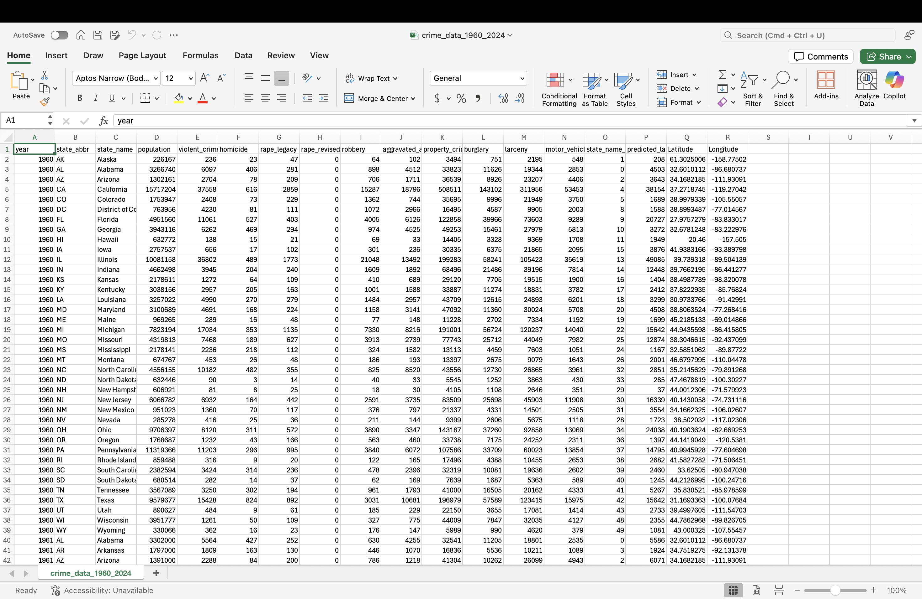
Dataset description
This dataset compiles historical crime statistics across U.S. states from 1960 to 2024, combining demographic, geographic, and criminal offense data. It serves as a foundation for temporal and spatial crime pattern analysis, often used in predictive modeling and clustering task.
Dataset

Slide 6
Column Name | Description
year | Year in which the crime data was reported
state_abbr | Abbreviation of the U.S. state (e.g., CA, TX)
state_name | Full name of the U.S. state
population | Total population of the state for that year
violent_crime | Total violent crimes (includes homicide, rape, robbery, assault)
homicide | Number of homicide cases
rape_legacy | Rape cases reported under the legacy definition
rape_revised | Rape cases reported under the revised FBI definition
robbery | Number of robbery cases
aggravated_assault | Number of aggravated assault cases
property_crime | Total property crimes (includes burglary, larceny, vehicle theft)
burglary | Number of burglary incidents
larceny | Number of larceny-theft incidents
motor_vehicle_theft | Number of motor vehicle thefts
state_name_index | Numeric encoding of the state name for machine learning
predicted_label | Cluster label assigned via ML algorithm (e.g., K-Means)
Latitude | Geographic latitude of the state center
Longitude | Geographic longitude of the state center

Slide 7
Synthetic dataset
Synthetic Dataset Purpose: It is artificially generated to simulate real-world crime data, enabling safe analysis without exposing sensitive or personal information.
Data Source & Processing: The dataset is loaded from an AWS S3 bucket, cleaned by removing duplicates, filling missing numeric values with zeros, and renaming columns for consistency.
Key Attributes: Includes state_name, population, and various crime metrics such as violent_crime, homicide, robbery, burglary, larceny, motor_vehicle, rape_legacy, rape_revised, aggravated, and property_crime.
Use in Analysis: Supports crime pattern identification, statistical correlation, and machine learning tasks like clustering and classification.
Benefits: Enhances privacy, offers flexibility for modeling rare or hypothetical crime scenarios, and facilitates large-scale analysis using tools like Spark and AWS.

Slide 8
KEY ATTRIBUTES FOR SYNTHETIC DATASET
state_name: Full name of the U.S. state.
state_abbr: State abbreviation.
year: Year of data record.
unemployment_rate: Percentage of unemployed individuals.
median_income: Median household income in USD.
poverty_rate: Percentage of the population below the poverty line.
high_school_completion_rate: Percent of population with high school education.
urbanization_rate: Percentage of the population living in urban areas.

Slide 9
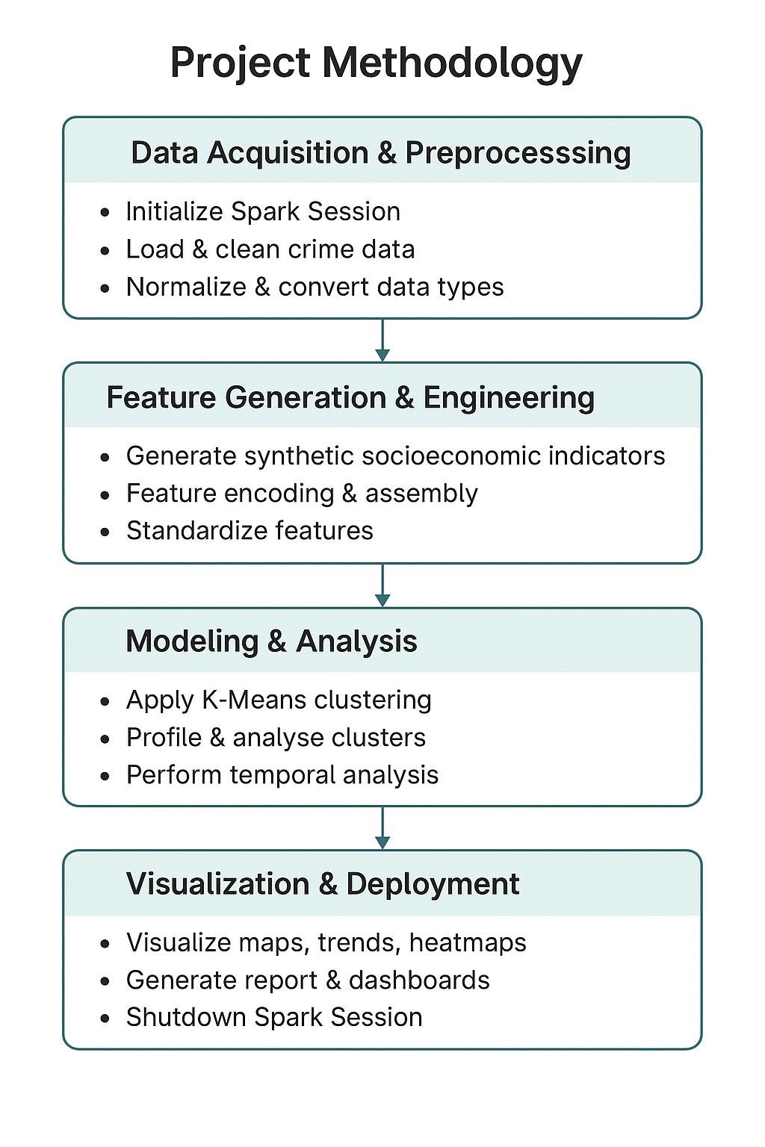
PROJECT METHDOLOGY

Slide 10
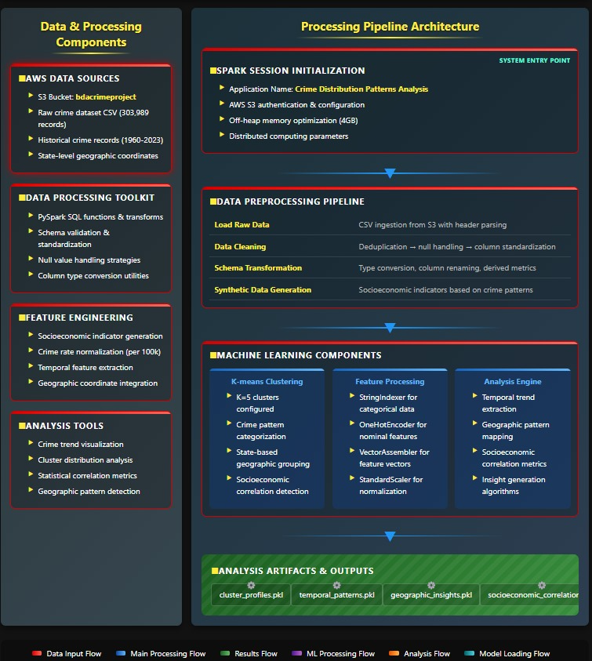
Architecture diagram

Slide 11
ALGORITHMS USED
1. K-Means Clustering
Used for unsupervised grouping of crime data records
Identifies k = 5 natural clusters based on crime and socioeconomic features
Enables state-wise classification into categories like “High Crime – Low Income”
Helps detect regional crime patterns and socioeconomic links
2. Random Forest (Exploratory Use)
Applied for supervised learning as an exploratory model
Used to validate clustering with precision/recall metrics
Not the core model but helps enhance model interpretability and benchmarking
3. Feature Engineering Algorithms
StringIndexer: Converts categorical string values (like state names) to numerical indices
OneHotEncoder: Encodes indexed values as binary vectors
VectorAssembler: Combines multiple features into a single feature vector
StandardScaler: Normalizes features to zero mean and unit variance for uniform processing
4. Temporal and Geographic Pattern Algorithms
Time-series analysis applied on crime trends over 60 years
Geographic mapping of clusters to track spatial migration and regional crime shifts

Slide 12
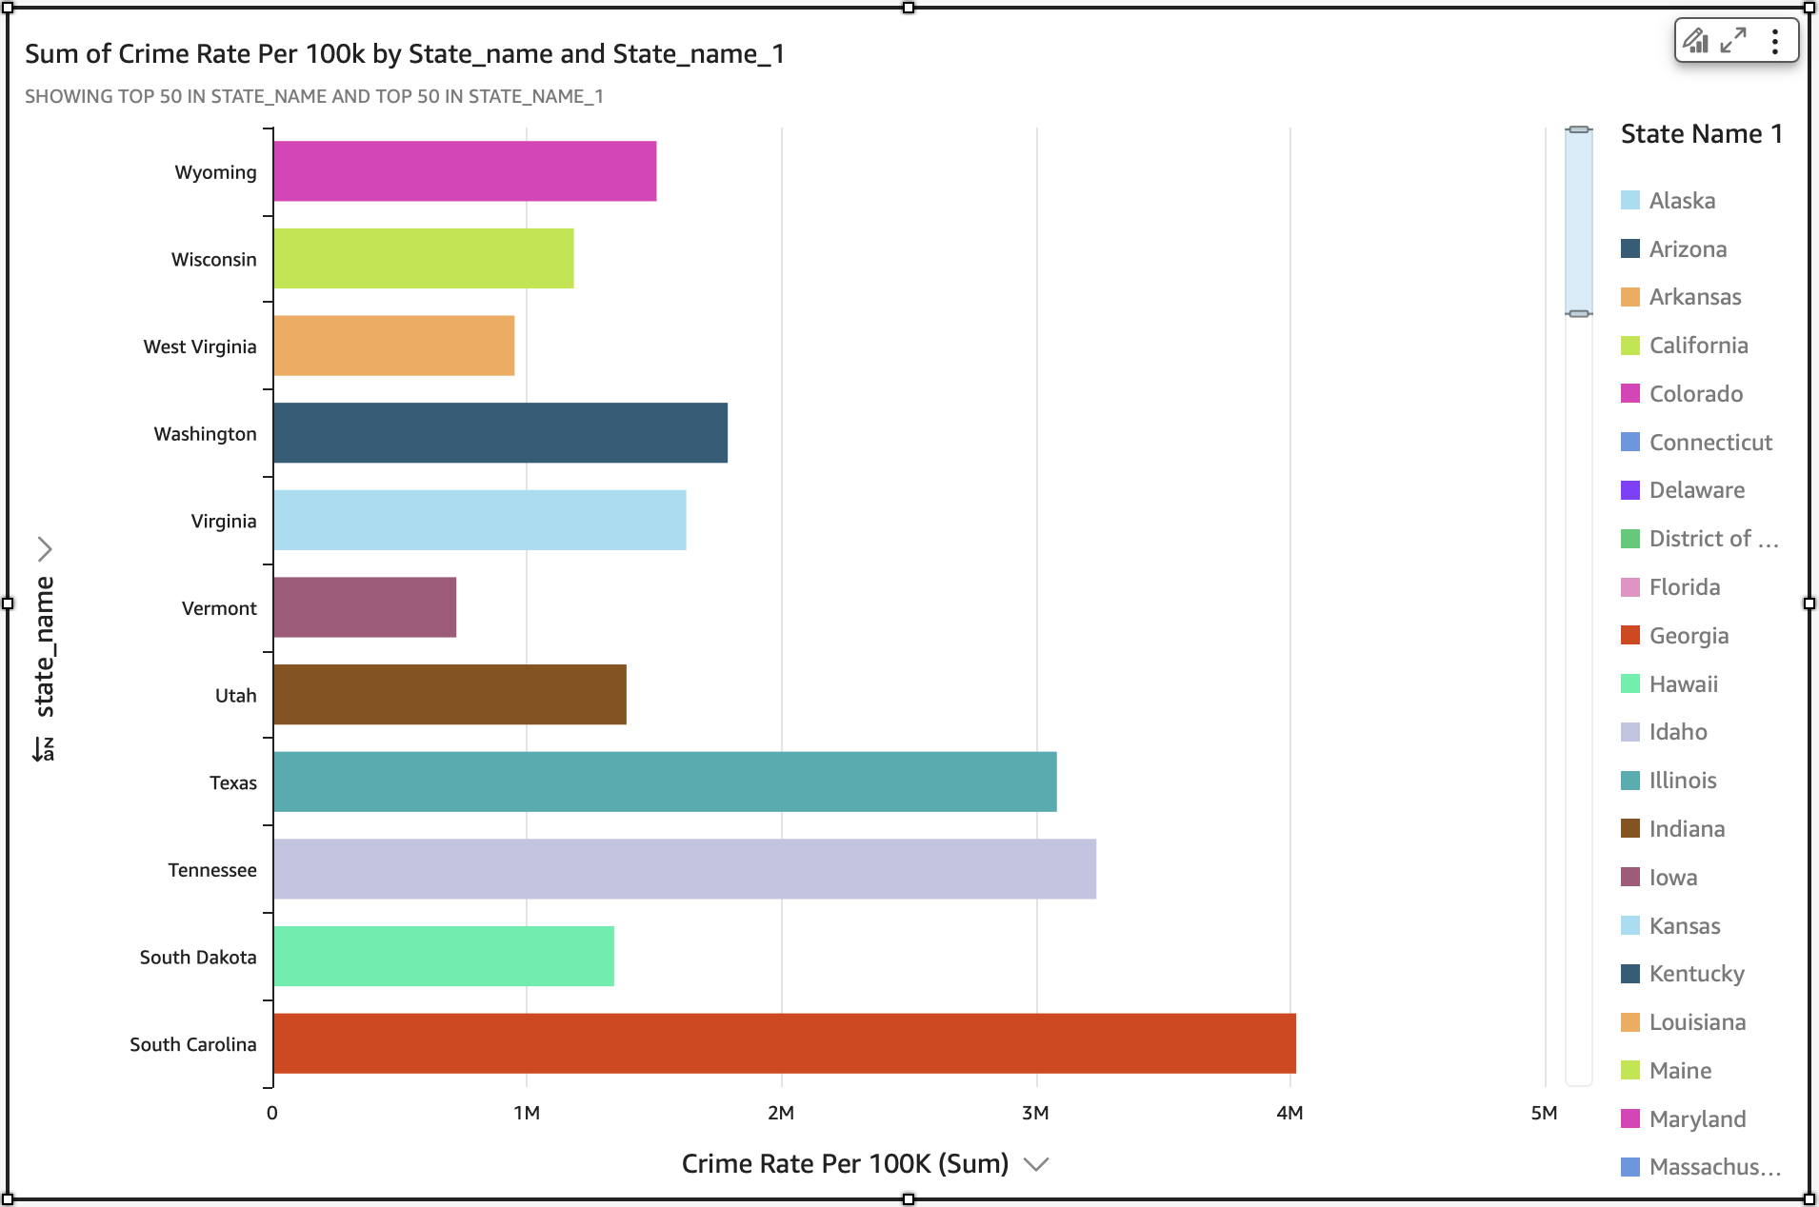
Visualization - 1
The chart displays the total crime rate
per 100,000 population across different U.S. states.
X-axis represents the sum of crime rate per 100,000 people.
Y-axis lists the state names.
Fig.1 Sum of Crime Rate Per 100k by State Name

Slide 13
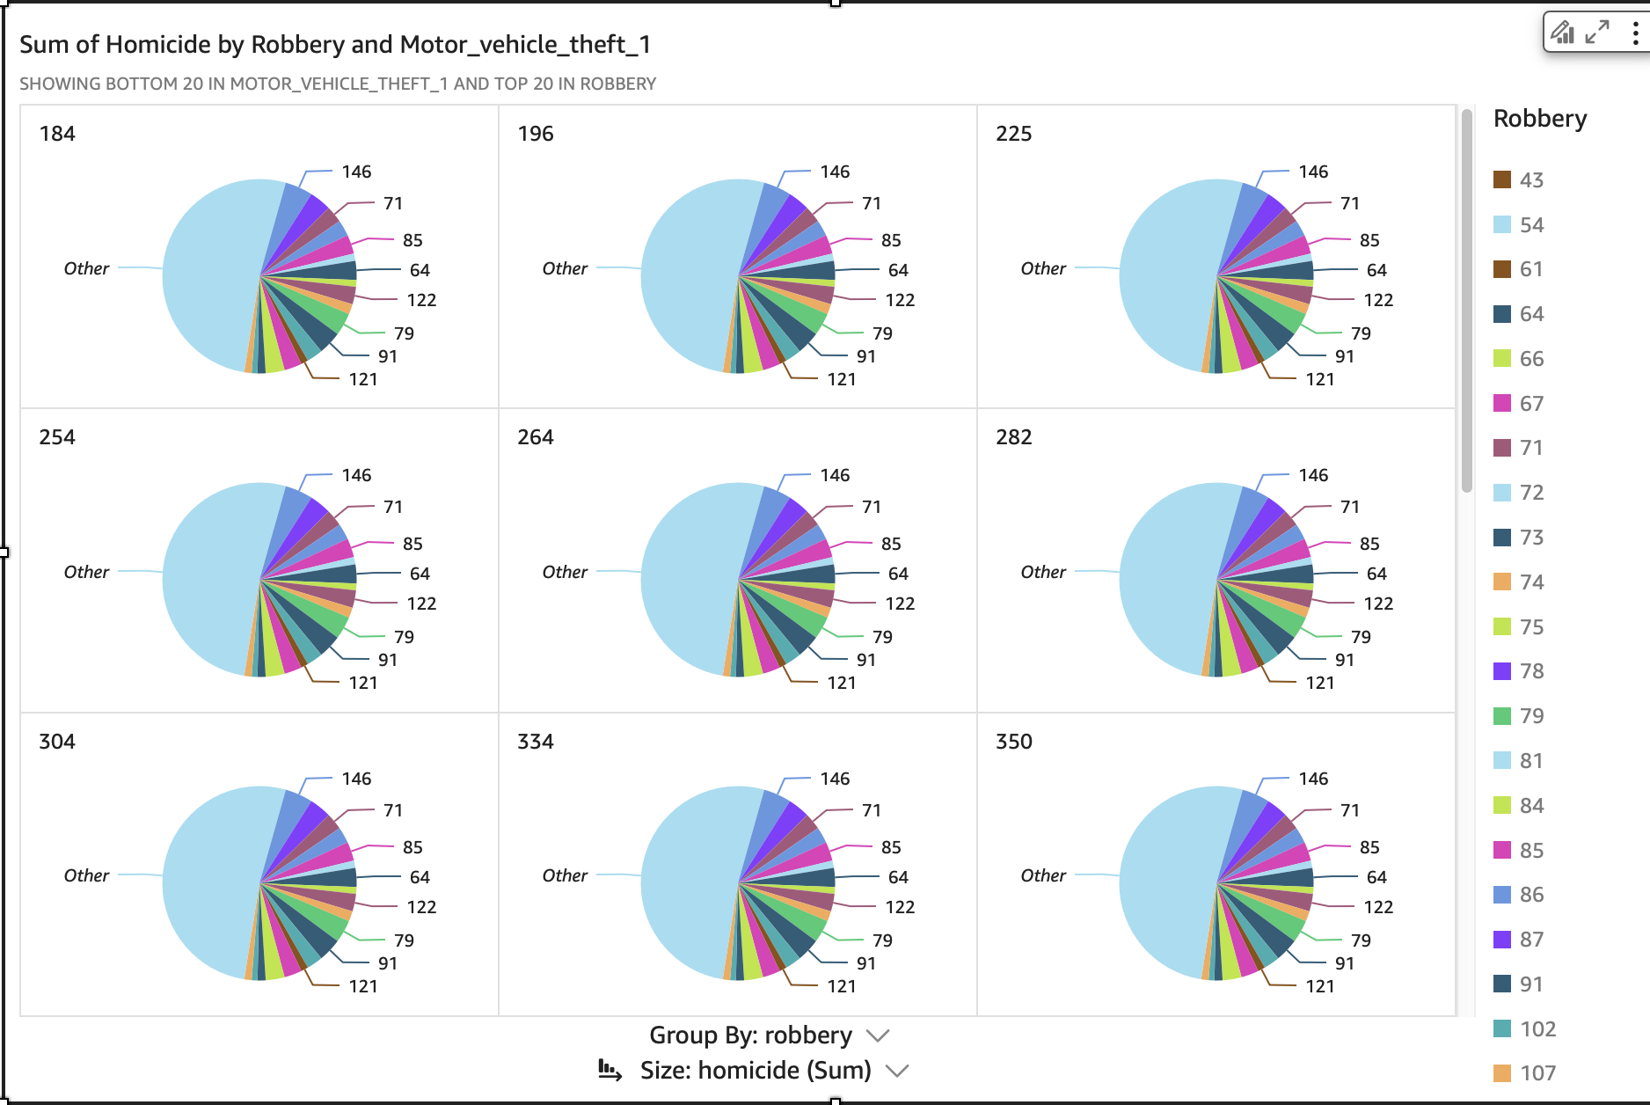
Visualization - 2
Multiple pie charts show homicide distribution
grouped by robbery category.
Each slice represents motor vehicle theft counts
linked to robberies.
"Other" section covers smaller, less frequent categories.
Colors differentiate robbery types (shown in the legend).
Group By: Robbery, Size: Total Homicides.
Helps analyze which robbery types are associated with higher homicide counts.
Fig.2 Analysis of Homicide Counts Grouped by Robbery Types

Slide 14
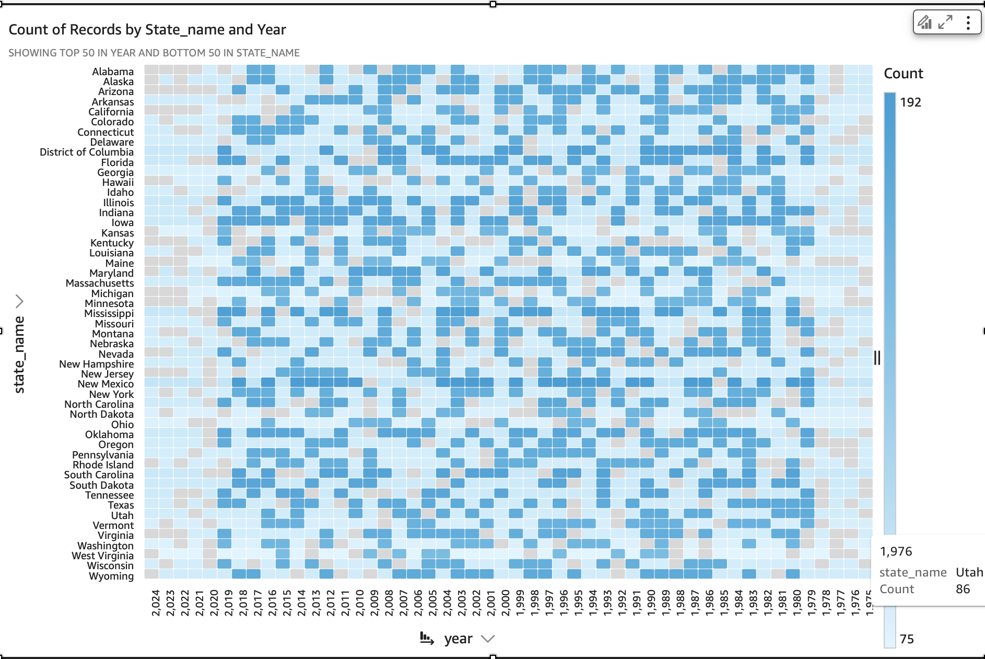
Visulization - 3
The visualization is a heatmap showing the number of crime records for each U.S. state across different years.
X-axis represents the year (from 1960 to 2024).
Y-axis lists the state names alphabetically.
The color intensity indicates the count of records — darker blue shades represent higher record counts.
States like North Carolina, California, and Florida show consistent high data counts across many years.
A tooltip (example: North Carolina, 1999, Count 88) displays detailed values when hovering over a specific cell.
Data density patterns help identify states and years with more crime reporting or better data availability
Fig.3Heatmap of Crime Record Counts by State and Year

Slide 15
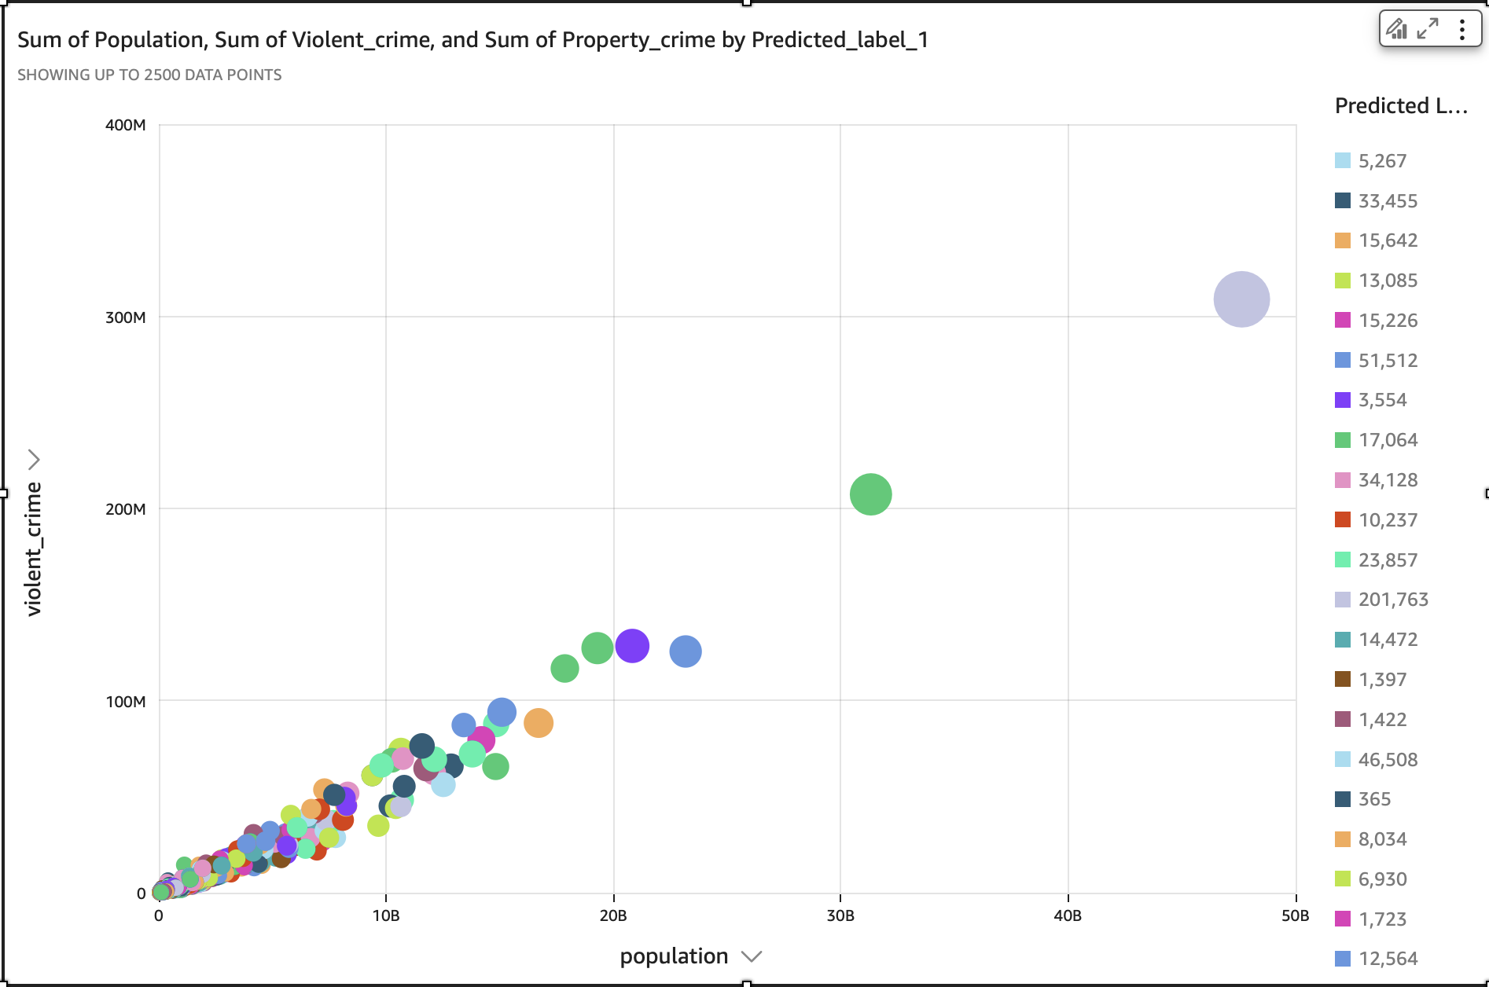
Visulaization - 4
There is a positive correlation between population size and violent crime—larger populations tend to have higher violent crime rates.
Clusters (as shown by color) help differentiate crime patterns across different states or regions.
A few clusters (larger bubbles) show exceptionally high property crime, indicating high-risk areas with large populations and high total crime counts.
Some smaller population areas also show disproportionate violent crime, suggesting localized hotspots that merit deeper analysis.
Fig.4 sum of population and violent crimes

Slide 16
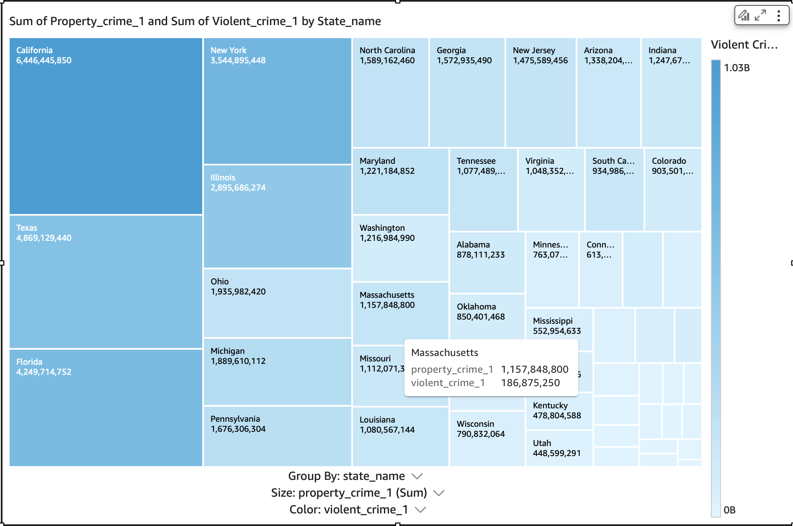
Visualization-5
Chart Overview
Visualizes total Property Crime and Violent Crime across U.S. states
Box Size: Represents total Property Crime
Box Color: Indicates Violent Crime intensity (darker = higher)
Key Insights
California, Texas, Florida, and New York have the highest property crimes
Darker shades reveal states with high violent crime rates
Smaller states like Kentucky, Utah show lower crime volumes
Balanced comparison of both property and violent crime by state
Fig-5 State-wise Crime Distribution

Slide 17
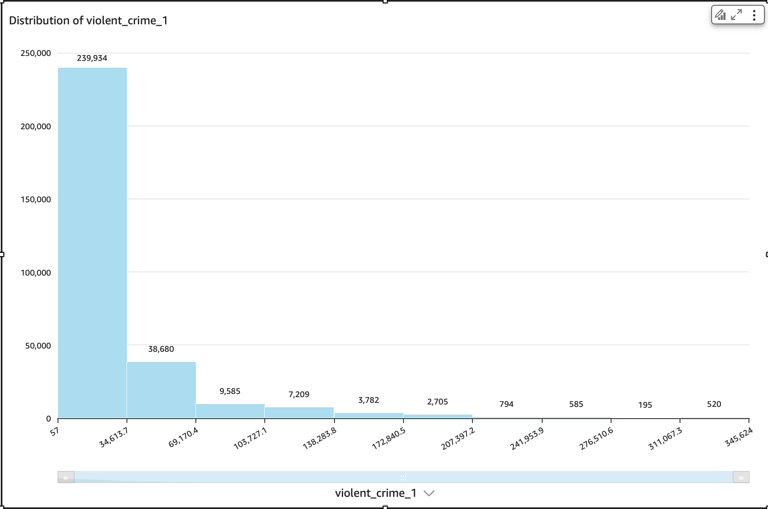
Visualization - 5
Right-skewed Distribution: The majority of violent crime records fall in the lower range (between 57 and ~35,000), indicating that most regions have relatively low violent crime counts.
Few High Outliers: Only a small number of regions exhibit extremely high violent crime values, as shown by the sparse bars on the right side of the histogram.
Fig.6 Distribution of violent crimes

Slide 18

Pros & cons
Pro’s
Scalable Architecture: Uses Apache Spark and AWS EMR to handle large-scale data (300K+ records over 60 years).
Enhanced Insights: Combines crime data with synthetic socioeconomic indicators for deeper pattern analysis.
Effective Clustering: K-Means algorithm segments data into meaningful crime groups (e.g., High Crime–Low Income zones).
Con’s
Synthetic Data Risk: Socioeconomic indicators are synthetically generated, which may introduce bias or reduce accuracy.
Lack of Ground Truth: Unsupervised models lack labeled data, making accuracy evaluation more subjective.
Temporal Drift: Changing definitions and crime-reporting standards over decades introduce inconsistencies.

Slide 19

Future work
Real-Time Data Integration:
While the current system analyses historical data, the addition of real-time crime feeds would render the model far more reactive and relevant. By taking advantage of technologies like Apache Kafka or Spark Streaming, the framework can be adapted to support live crime monitoring. This would allow the authorities to react promptly to emerging trends in crime and enable proactive policing initiatives.
Causal Inference and Policy Simulation:
Aside from correlation, causal links between socioeconomic variables and crime can be investigated in future research. Causal links can be established using tools such as DoWhy or structural equation modelling. Simulated interventions—e.g., education budget increases or poverty reduction programs—can then be modelled to investigate their potential impact on crime trends.

Slide 20

Thank You!

